Slide 1
Boost Memory management

Slide 2
Agenda
RAII
Smart ptr in Boost
Memory Pool/Object_pool/Singleton_pool

Slide 3
RAII introduction
Resource Acquisition Is Initialization (RAII)
The technique was invented by Bjarne Stroustrup to deal with resource allocation and release in C++.

Slide 4
RAII typical scenarios
Scenario 1:
Control mutex locks in multi-threaded applications.
Scenario 2:
We could have an object that represents a file that is open for writing, wherein the file is opened in the constructor and closed when the object goes out of scope.
Notes:
The RAII design is often used for controlling mutex locks in multi-threaded applications. In that use, the object releases the lock when destroyed. Without RAII in this scenario the potential for deadlock would be high and the logic to lock the mutex would be far from the logic to unlock it. With RAII, the code that locks the mutex essentially includes the logic that the lock will be released when the RAII object goes out of scope.
We could have an object that represents a file that is open for writing, wherein the file is opened in the constructor and closed when the object goes out of scope.
In both cases, RAII ensures only that the resource in question is released appropriately; care must still be taken to maintain exception safety. If the code modifying the data structure or file is not exception-safe, the mutex could be unlocked or the file closed with the data structure or file corrupted.

Slide 5
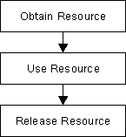
Code for File operation
void UseFile(char const* fn)
{
FILE* f = fopen(fn, "r"); // obtain resource
// ...
if (!g()) { fclose(f); return; }
// ...
if (!h()) { fclose(f); return; }
// ...
fclose(f); // release resource
}

Slide 6
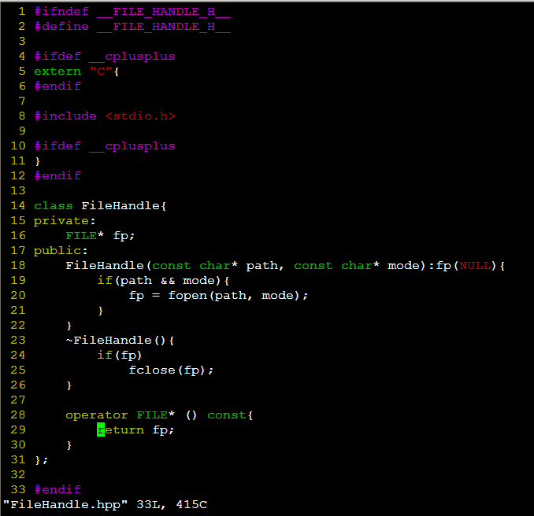
Demo code for RAII

Slide 7
Use FileHandle in code
void UseFile(char const* fn)
{
FileHandle fp(fn, "a+");// obtain resource
// ...
if (!g()) { fclose(f); return; }
// ...
if (!h()) { fclose(f); return; }
// ...
fclose(f); // release resource
}

Slide 8
Smart ptr in boost
scoped_ptr | <boost/scoped_ptr.hpp> | Simple sole ownership of single objects. Noncopyable.
scoped_array | <boost/scoped_array.hpp> | Simple sole ownership of single objects. Noncopyable.
shared_ptr | <boost/shared_ptr.hpp> | Object ownership shared among multiple pointers.
shared_array | <boost/shared_array.hpp> | Array ownership shared among multiple pointers.
weak_ptr | <boost/weak_ptr.hpp> | Non-owning observers of an object owned by shared_ptr.
intrusive_ptr | <boost/intrusive_ptr.hpp> | Shared ownership of objects with an embedded reference count.

Slide 9
scoped_ptr
The scoped_ptr class template stores a pointer to a dynamically allocated objects.(Dynamically allocated objects are allocated with the C++ new expression.)
The object pointed to is guaranteed to be deleted, either on destruction of the scoped_ptr, or via an explicit reset.
Feature:
Retain ownership solely within the current scope.
Noncopyable
Cannot be used in C++ Standard Library containers.
Cannot correctly hold a pointer to a dynamically allocated array.

Slide 10
scoped_ptr members
void reset(T * p = 0); // never throws
T & operator*() const; // never throws
T * operator->() const; // never throws
T * get() const; // never throws
void swap(scoped_ptr & b); // never throws
operator bool () const; // never throws

Slide 11
Scoped_array
The scoped_array class template stores a pointer to a dynamically allocated objects.(Dynamically allocated objects are allocated with the C++ new[] expression.)
The object pointed to is guaranteed to be deleted, either on destruction of the scoped_array, or via an explicit reset.
Feature:
Retain ownership solely within the current scope.
Noncopyable
Cannot be used in C++ Standard Library containers.
Cannot correctly hold a pointer to a single object.

Slide 12
scoped_array members
void reset(T * p = 0); // never throws
T & operator*() const; // never throws
T * operator->() const; // never throws
T * get() const; // never throws
void swap(scoped_ptr & b); // never throws
operator bool () const; // never throws
T & operator[](std::ptrdiff_t i) const; // never throws

Slide 13
shared_ptr
The shared_ptr class template stores a pointer to a dynamically allocated object, typically with a C++ new-expression.
The object pointed to is guaranteed to be deleted when the last shared_ptr pointing to it is destroyed or reset.

Slide 14
shared_ptr member
void reset(); // never throws
template<class Y> void reset(Y * p);
template<class Y, class D> void reset(Y * p, D d);
template<class Y, class D, class A> void reset(Y * p, D d, A a);
template<class Y> void reset(shared_ptr<Y> const & r, element_type * p); // never throws
T & operator*() const; // never throws; only valid when T is not an array type
T * operator->() const;
element_type & operator[](std::ptrdiff_t i) const; // never throws; only valid when T is an array type
element_type * get() const; // never throws
bool unique() const; // never throws
long use_count() const; // never throws
explicit operator bool() const; // never throws
void swap(shared_ptr & b); // never throws

Slide 15
Advanced usage
Factory function (make_shared)
Used in standard(STL) containers
Bridge mode
Factory mode
Customize deleted function

Slide 16
Shared_array
The shared_array class template stores a pointer to a dynamically allocated objects.(Dynamically allocated objects are allocated with the C++ new[] expression.)
The object pointed to is guaranteed to be deleted when the last shared_array pointing to it is destroyed or reset.

Slide 17
Weak_ptr
Weak_ptr not smart_ptr, it is shared_ptr assistant.

Slide 18
Problem
shared_ptr<int> p(new int(5));
weak_ptr<int> q(p);
// some time later
if(int * r = q.get())
{
// use *r
}
Notes:
Compared to shared_ptr, weak_ptr provides a very limited subset of operations since accessing its stored pointer is often dangerous in multithreaded programs, and sometimes unsafe even within a single thread (that is, it may invoke undefined behavior.) Pretend for a moment that weak_ptr has a get member function that returns a raw pointer, and consider this innocent piece of code:

Slide 19
Solutions
shared_ptr<int> p(new int(5));
weak_ptr<int> q(p);
// some time later
if(shared_ptr<int> r = q.lock())
{
// use *r
}
Notes:
Now r holds a reference to the object that was pointed by q. Even if p.reset() is executed in another thread, the object will stay alive until r goes out of scope or is reset. By obtaining a shared_ptr to the object, we have effectively locked it against destruction.

Slide 20
pool
The pool interface is a simple Object Usage interface with POD(Plain old data) Return.

Slide 21
pool member
bool release_memory();
bool purge_memory();
bool is_from(void * chunk) const;
size_type get_requested_size() const;
void * malloc();
void * ordered_malloc();
void * ordered_malloc(size_type n);
void free(void * chunk);
void ordered_free(void * chunk);
void free(void * chunks, size_type n);
void ordered_free(void * chunks, size_type n);

Slide 22
Object_pool
The template class object_pool interface is an Object Usage interface with Null Return, but is aware of the type of the object for which it is allocating chunks.
On destruction, any chunks that have been allocated from that object_pool will have their destructors called.
On construction, the constructors will not be called.
Only support max 3 parameters on construct.

Slide 23
Object_pool member
element_type * malloc();
void free(element_type * p);
bool is_from(element_type * p) const;
element_type * construct();
// other construct() functions
void destroy(element_type * p);

Slide 24
singleton_pool
The singleton_pool interface at singleton_pool.hpp is a Singleton Usage interface with Null Return. It's just the same as the pool interface but with Singleton Usage instead.

Slide 25
singleton_pool member
static bool is_from(void * ptr);
static void * malloc();
static void * ordered_malloc();
static void * ordered_malloc(size_type n);
static void free(void * ptr);
static void ordered_free(void * ptr);
static void free(void * ptr, std::size_t n);
static void ordered_free(void * ptr, size_type n);
static bool release_memory();
static bool purge_memory();

Slide 26
pool_allocator
The pool_allocator interface is a Singleton Usage interface with Exceptions. It is built on the singleton_pool

Slide 27


Thank You

